Slide 1
Competitive Programming
12 July 2024

Slide 2
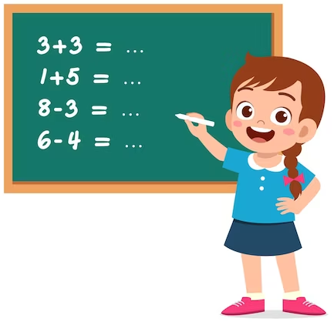
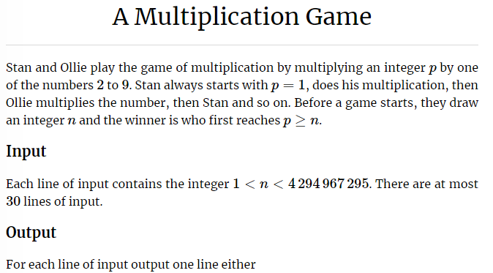
Practice – Game Theory
Kattis: https://open.kattis.com/problems/amultiplicationgame
Task ID: amultiplicationgame

Slide 3
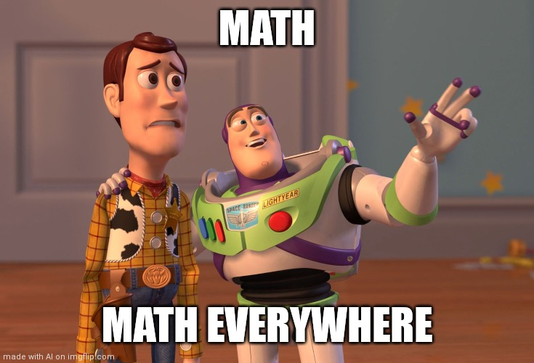
Game Theory in Competitive Programming

Slide 4
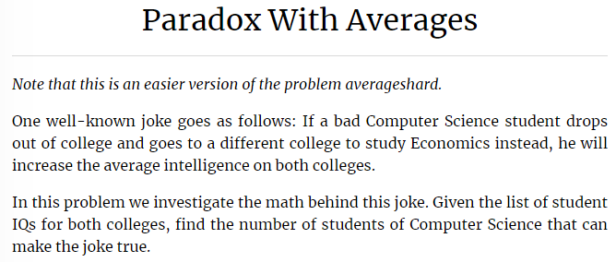
Other Math Problems - I
Kattis: https://open.kattis.com/problems/averageseasy

